Slide 1

Encryption and Integrity

Slide 2
Options I
How are Encryption & Integrity used together?
Notation:
Message M
Encryption key k1
Integrity key k2

Slide 3
Options II
M ➔ E_{k1}(M) || MAC_{k2}(M))
M ➔ E_{k1}(M || MAC_{k2}(M))
E.g. TLS
M ➔ E_{k1}(M) || MAC_{k2}(E_{k1}(M))
E.g. IPsec

Slide 4
Replay Attack
Replay attack
Attacker receives valid (M, MAC_{k}(M))
Attacker sends pair more than once
Protection mechanisms
Time stamp
Ordered transmission: e.g. TCP
Counter

Slide 5
Public Key Cryptography

Slide 6
Downside of Symmetry
Symmetric Cryptography enables
Encryption
Authentication
Does not provide key agreement
Alice and Bob agree on keys
Ahead of time
Out of band

Slide 7
Pub. Key Crypto – Goals I
Key exchange
Alice and Bob agree on a shared key k
No out-of-band communication
Eavesdropping Eve has no information on k
Key k used for symmetric Crypto
Encryption & authentication

Slide 8
Pub. Key Crypto – Goals II
Public key encryption
Asymmetric keys
Public key
Used for encryption
Private key
Held by single party
Used for decryption

Slide 9
Pub. Key Crypto – Goals III
Public key authentication (digital signatures)
Asymmetric keys
Private key
Held by single party
Used for signing
Public key
Used for verification

Slide 10
Discrete Logarithm I
Let (G,⊕) be a group and g∈G.
g is called the base.
Let y=g^{x}
y∈G
x∈{0,…,O(g)-1}
x is called the discrete log of y

Slide 11

Discrete Logarithm II
Example:
(G,⊕)=$(ℤ_{p},+_{p})$
y=gx mod p
Example:
(G,⊕)=$(ℤ_{p}^{∗},∙_{p})$
y=g^{x} mod p

Slide 12
Computing DLOG I
Computing discrete logarithm
Input: (G,⊕), g, y
Output: x s.t. g^{x}=y
Trivial algorithm
Check whether g^{x}=y for all x∈G
Computation O(|G|)

Slide 13
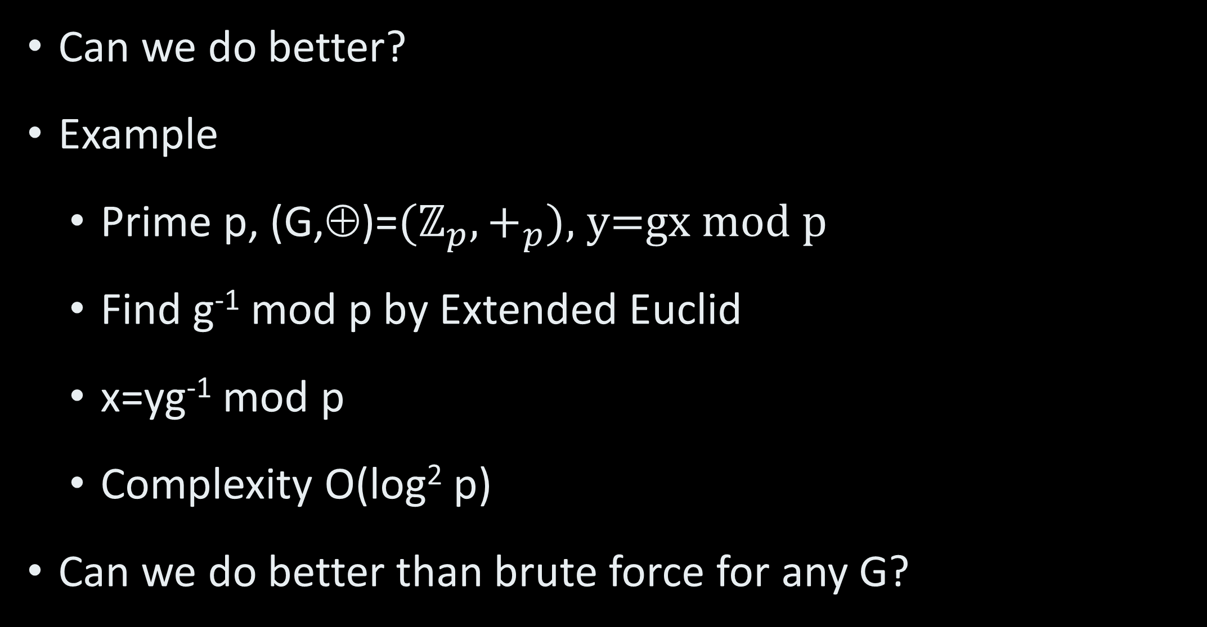
Computing DLOG II
Can we do better?
Example
Prime p, (G,⊕)=$(ℤ_{p},+_{p})$, y=gx mod p
Find g⁻¹ mod p by Extended Euclid
x=yg⁻¹ mod p
Complexity O(log² p)
Can we do better than brute force for any G?

Slide 14
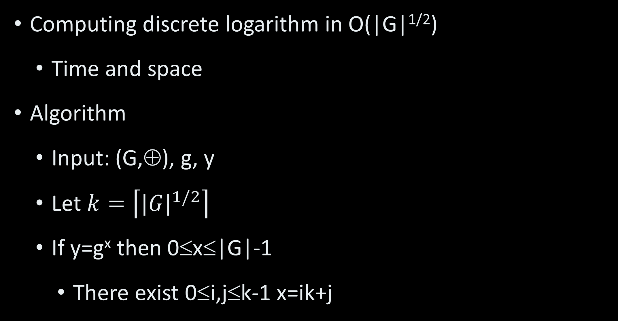
Giant Step Baby Step I
Computing discrete logarithm in O(|G|^{1/2})
Time and space
Algorithm
Input: (G,⊕), g, y
Let $k=\left\lceil {|G|}^{1/2}\right\rceil$
If y=g^{x} then 0≤x≤|G|-1
There exist 0≤i,j≤k-1 x=ik+j

Slide 15
Giant Step Baby Step II
Algorithm (cont.)
Giant step
Compute g^{ik} for 0≤i≤k-1
Store (i, g^{ik}) in table
Baby step
For 0≤j≤k-1, compute yg^{-j}
If g^{ik}=yg^{-j} return x=ik+j

Slide 16
Giant Step Baby Step III
Correctness – returns x with probability 1
Performance
Giant step time and space O(k)
Baby step time O(k), space O(1)
Total time O(k), total space O(k)

Slide 17
Kangaroo Algorithm I
Compute discrete logarithm
O(|G|^{1/2}) time, O(1) space
First idea
Random walk from g
Random walk from y
Compute steps from g and y to find x

Slide 18
Kangaroo ||
Group G
Collision – compute x
y=g^{x}
g
Collision after O(|G|^{1/2}) steps
But, finding it requires
O(|G|) time / O(|G|^{1/2}) time + O(|G|^{1/2}) space

Slide 19
Kangaroo III
Idea 2:
Random function f:G→ℤ_{|G|}
Random step: from h∈G to h⋅g^{f(h)}
Same function used for both walks
Consequence:
After collision, two walks are identical!

Slide 20
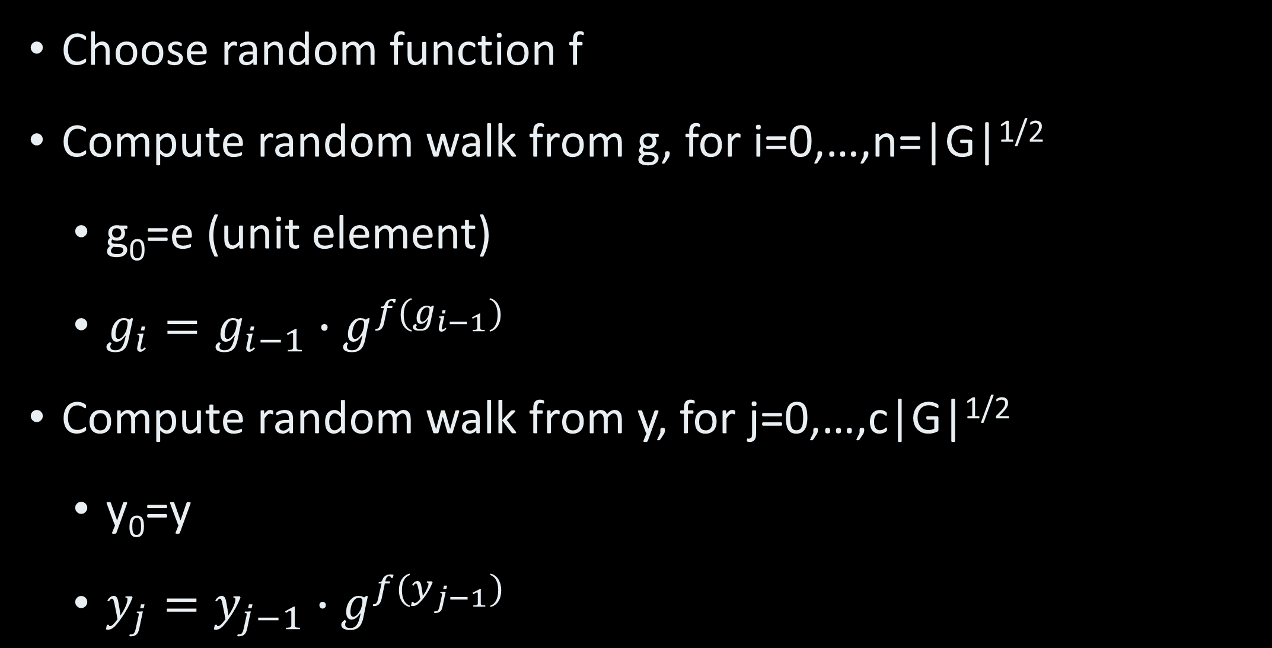
Kangaroo in Detail I
Choose random function f
Compute random walk from g, for i=0,…,n=|G|^{1/2}
g₀=e (unit element)
$g_{i}=g_{i−1}∙g^{{f(g}_{i−1})}$
Compute random walk from y, for j=0,…,c|G|^{1/2}
y₀=y
$y_{j}=y_{j−1}∙g^{{f(y}_{j−1})}$

Slide 21
Kangaroo in Detail II
If y_{j}=g_{n} for some j then
g_{n}=g^{s} for s=Σ_{k<i} f(g_{k})
y_{j}=yg^{s’} for s’=Σ_{k<j} f(y_{k})
y=g^{s-s’} and x=s-s’
If y_{j}≠g_{n} for all j then the algorithm fails

Slide 22
Kangaroo Analysis
Probability of success – ½
Can be amplified to 1-2^{-k} with k iterations
Random walk from g
O(|G|^{1/2}) time and O(1) space
Random walk from y
O(|G|^{1/2}) time and O(1) space
Representation of f
O(|G|) group elements

Slide 23
Random Oracle Model
Random oracle = random function
Random Oracle Model
Common assumption
Random Oracle computationally indistinguishable from CRHF
Replace f in Kangaroo by SHA-3
➔Time O(|G|^{1/2}), space – O(1)

Slide 24
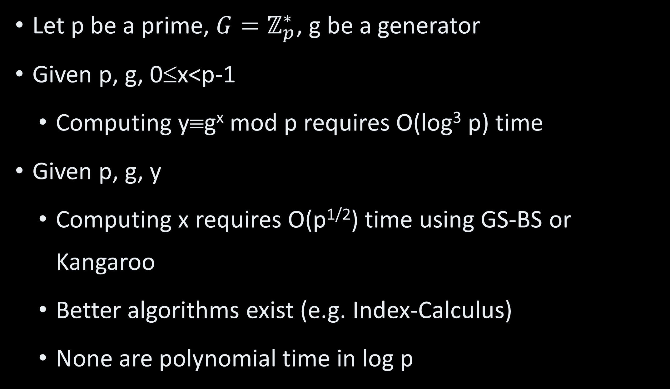
Standard Discrete Log I
Let p be a prime, $G=ℤ_{p}^{∗}$, g be a generator
Given p, g, 0≤x<p-1
Computing y≡g^{x} mod p requires O(log³ p) time
Given p, g, y
Computing x requires O(p^{1/2}) time using GS-BS or Kangaroo
Better algorithms exist (e.g. Index-Calculus)
None are polynomial time in log p

Slide 25
Standard Discrete Log II
The function (p,g,x) → y≡g^{x} mod p is considered OWF
If p is large enough
p should be at least 1024 bits
Current recommendation p≥2²⁰⁴⁸

Slide 26
Diffie-Hellman Key Exchange

Slide 27
DH Key Exchange I
Alice
Bob
Initial info: prime p, generator g
Initial info: prime p, generator g
Choose random x∈{0….,p-2}
Choose random y∈{0….,p-2}
Compute w≡g^{x} mod p
Compute z≡g^{y} mod p
w
z
Compute k≡ z^{x}
≡ g^{xy} mod p
Compute k≡ w^{y}
≡ g^{xy} mod p

Slide 28
DH Key Exchange II
Terms
x (or y) – private key
g^{x} mod p (or g^{y} mod p) – public key
k≡g^{xy} mod p – shared key

Slide 29
DH Key Exchange III
Performance
Two modular exponentiations
O(log³ p) time
50-100 key exchanges a second in real-world SW
About 10 times that in HW. Beyond that- a heavy penalty in gate count

Slide 30
DH Security Overview
How do we argue that Diffie-Hellman is secure?
Is it necessary that discrete log is OWF?
Yes, otherwise Eve gets
Private keys
Shared key

Slide 31
DH Security Overview II
Is it sufficient that discrete log is OWF?
No
Example I: shared key is k=g^{x+y} mod p
Example II: OWF may leak some bits of private key

Slide 32
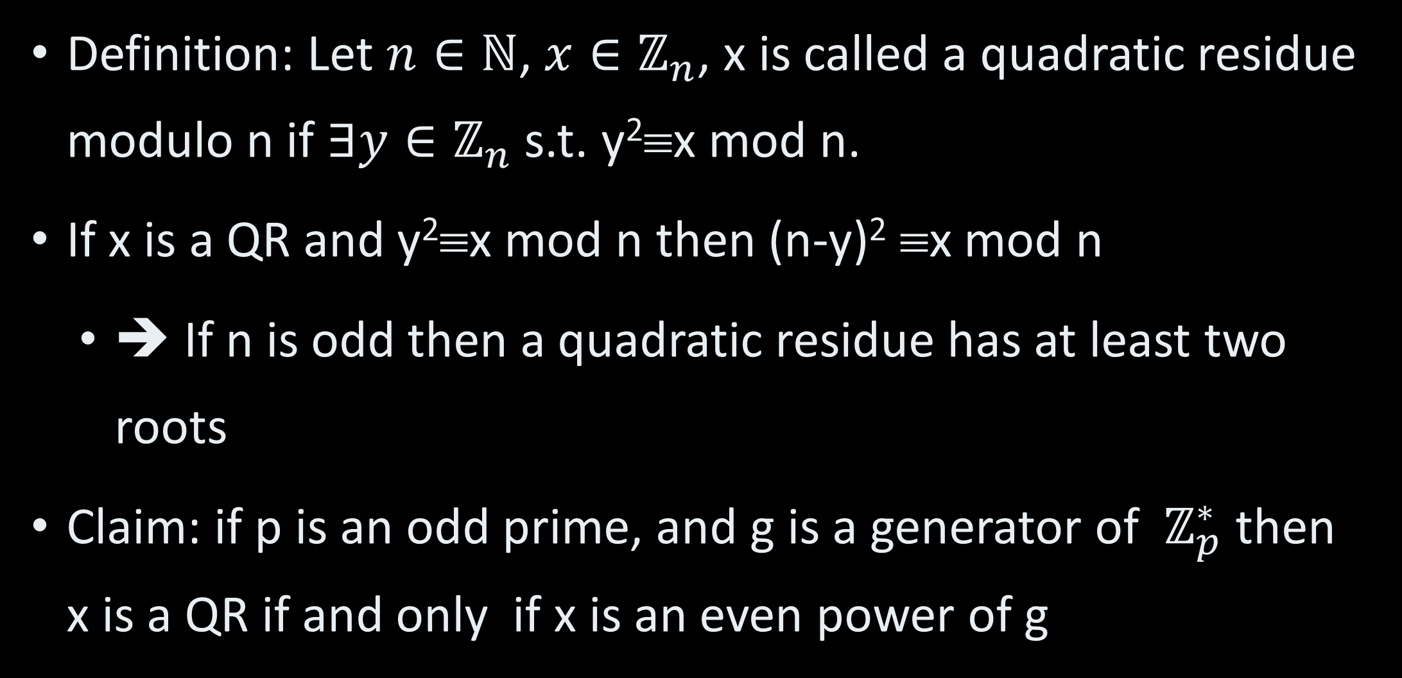
Quadratic Residues I
Definition: Let $n∈ℕ$, $x∈ℤ_{n}$, x is called a quadratic residue modulo n if $∃y∈ℤ_{n}$ s.t. y²≡x mod n.
If x is a QR and y²≡x mod n then (n-y)² ≡x mod n
➔ If n is odd then a quadratic residue has at least two roots
Claim: if p is an odd prime, and g is a generator of $ℤ_{p}^{∗}$ then x is a QR if and only if x is an even power of g

Slide 33
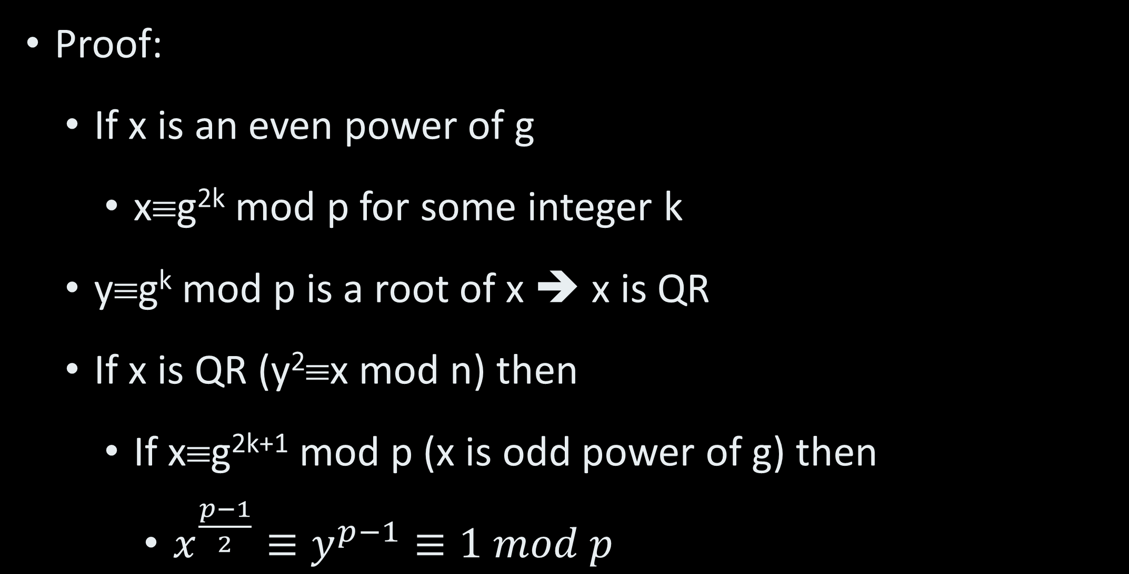
Quadratic Residues II
Proof:
If x is an even power of g
x≡g^{2k} mod p for some integer k
y≡g^{k} mod p is a root of x ➔ x is QR
If x is QR (y²≡x mod n) then
If x≡g^{2k+1} mod p (x is odd power of g) then
$x^{\frac{p−1}{2}}≡y^{p−1}≡1 mod p$

Slide 34
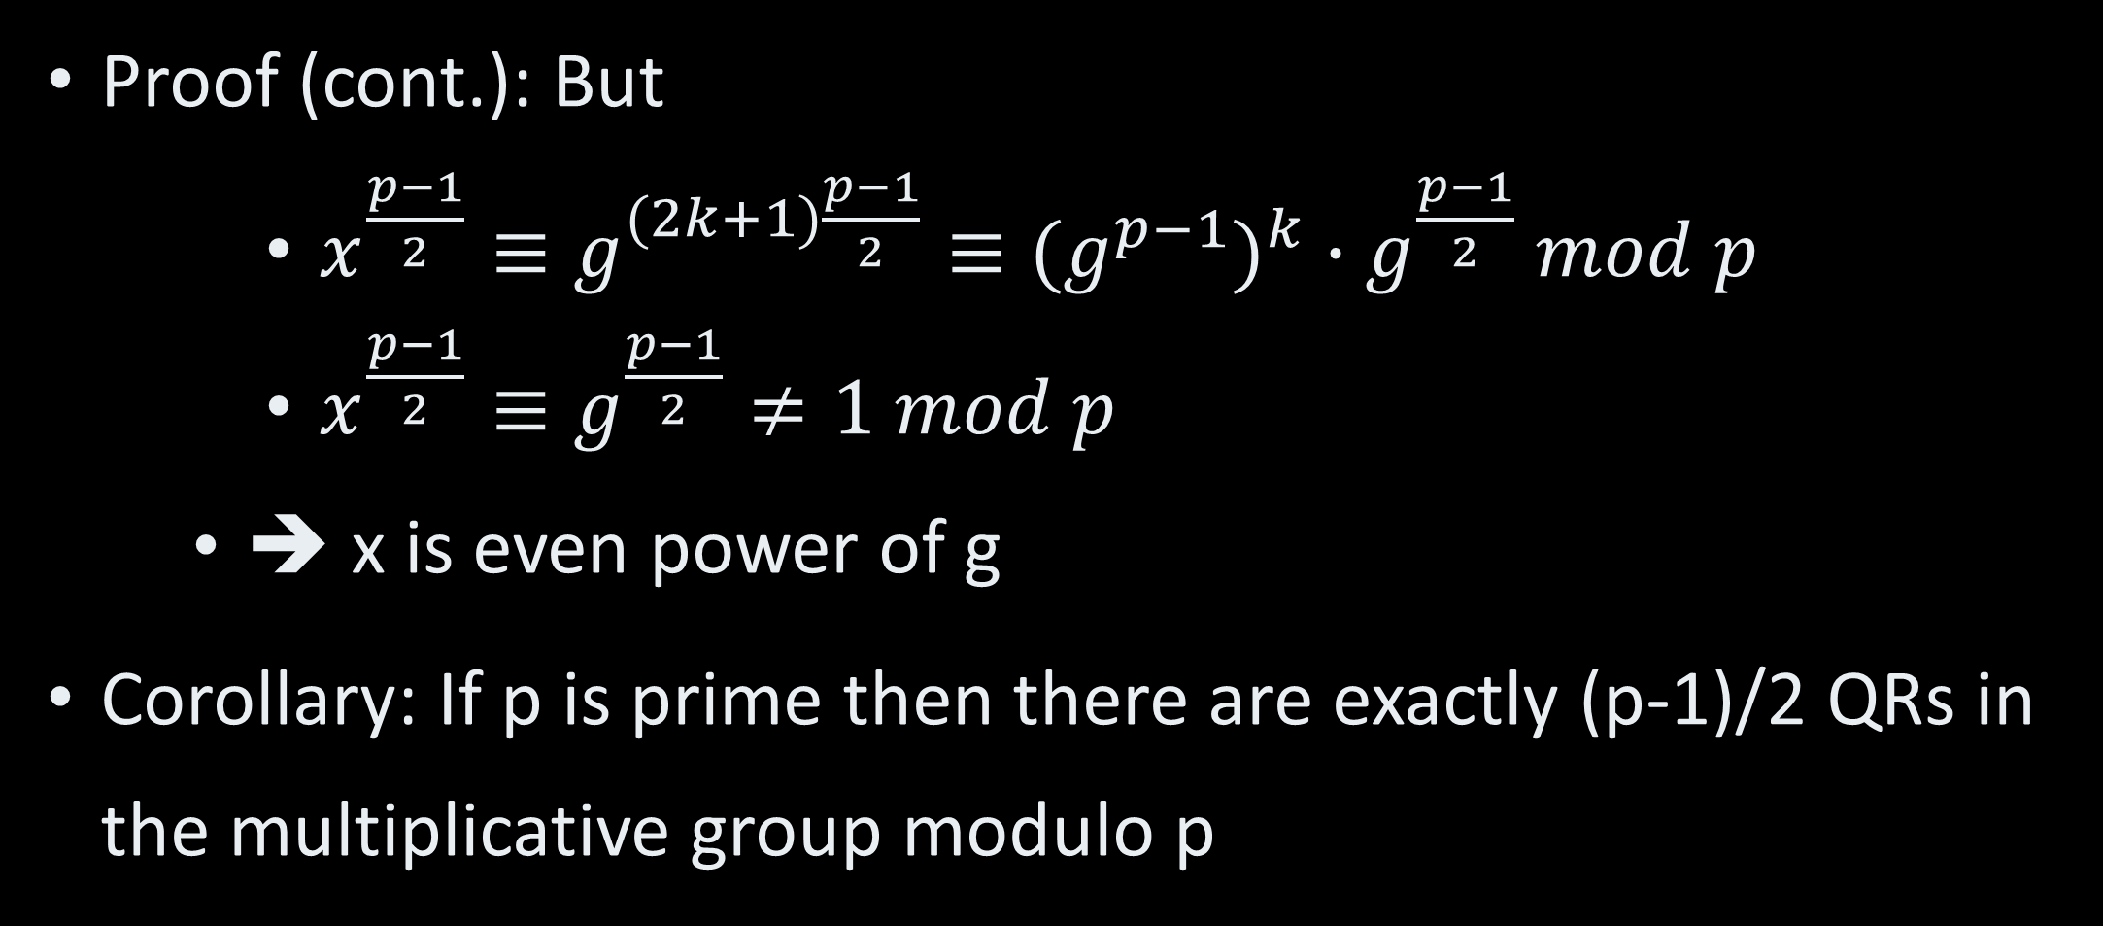
Quadratic Residues III
Proof (cont.): But
$x^{\frac{p−1}{2}}≡g^{(2k+1)\frac{p−1}{2}}≡(g^{p−1})^{k}∙g^{\frac{p−1}{2}} mod p$
$x^{\frac{p−1}{2}}≡g^{\frac{p−1}{2}}≠1 mod p$
➔ x is even power of g
Corollary: If p is prime then there are exactly (p-1)/2 QRs in the multiplicative group modulo p

Slide 35
Computing QR I
Claim: If p is prime then if x is a QR modulo p then x^{(p-1)/2}≡1 mod p and if x is not a QR then x^{(p-1)/2}≡-1 mod p
Proof:
If x is QR then
x≡g^{2k} mod p
➔x^{(p-1)/2}≡x^{(p-1)k}≡1 mod p

Slide 36
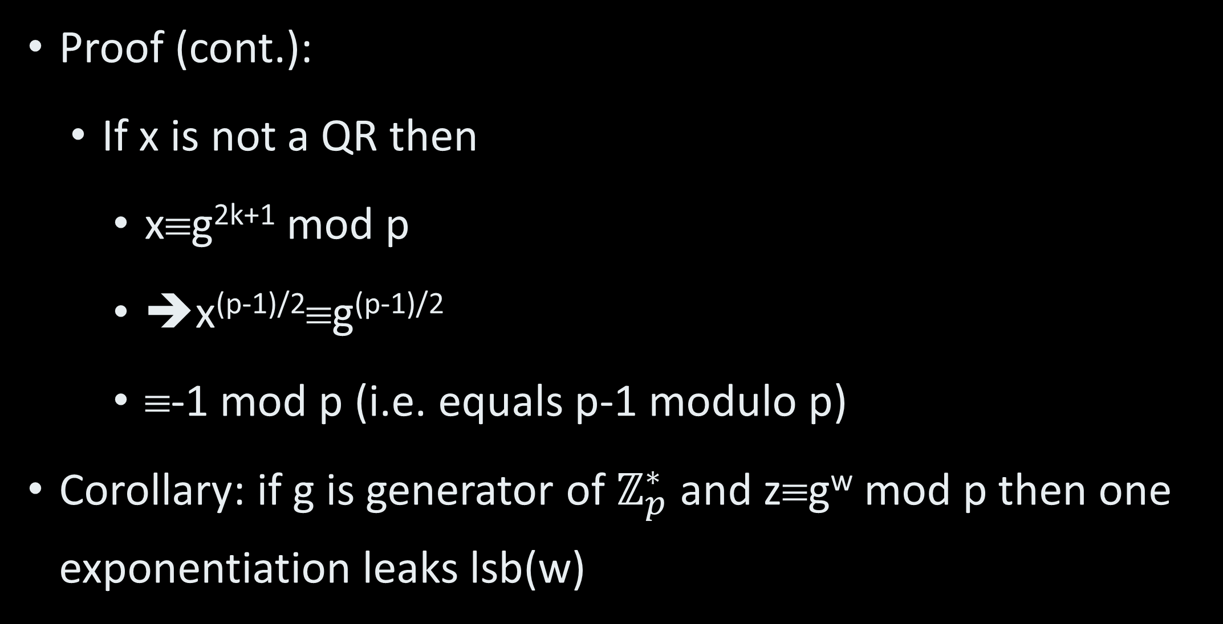
Computing QR II
Proof (cont.):
If x is not a QR then
x≡g^{2k+1} mod p
➔x^{(p-1)/2}≡g^{(p-1)/2}
≡-1 mod p (i.e. equals p-1 modulo p)
Corollary: if g is generator of $ℤ_{p}^{∗}$ and z≡g^{w} mod p then one exponentiation leaks lsb(w)

Slide 37
DH Security I
Intuition
Eve must get no information on shared key
Given all information she has
Information includes p, g, g^{x} mod p, g^{y} mod p
Formally (Decisional Diffie-Hellman assumption):
Given (p, g, g^{x} mod p, g^{y} mod p) it is computationally hard to distinguish between g^{xy} mod p and g^{r} mod p for a random r.

Slide 38
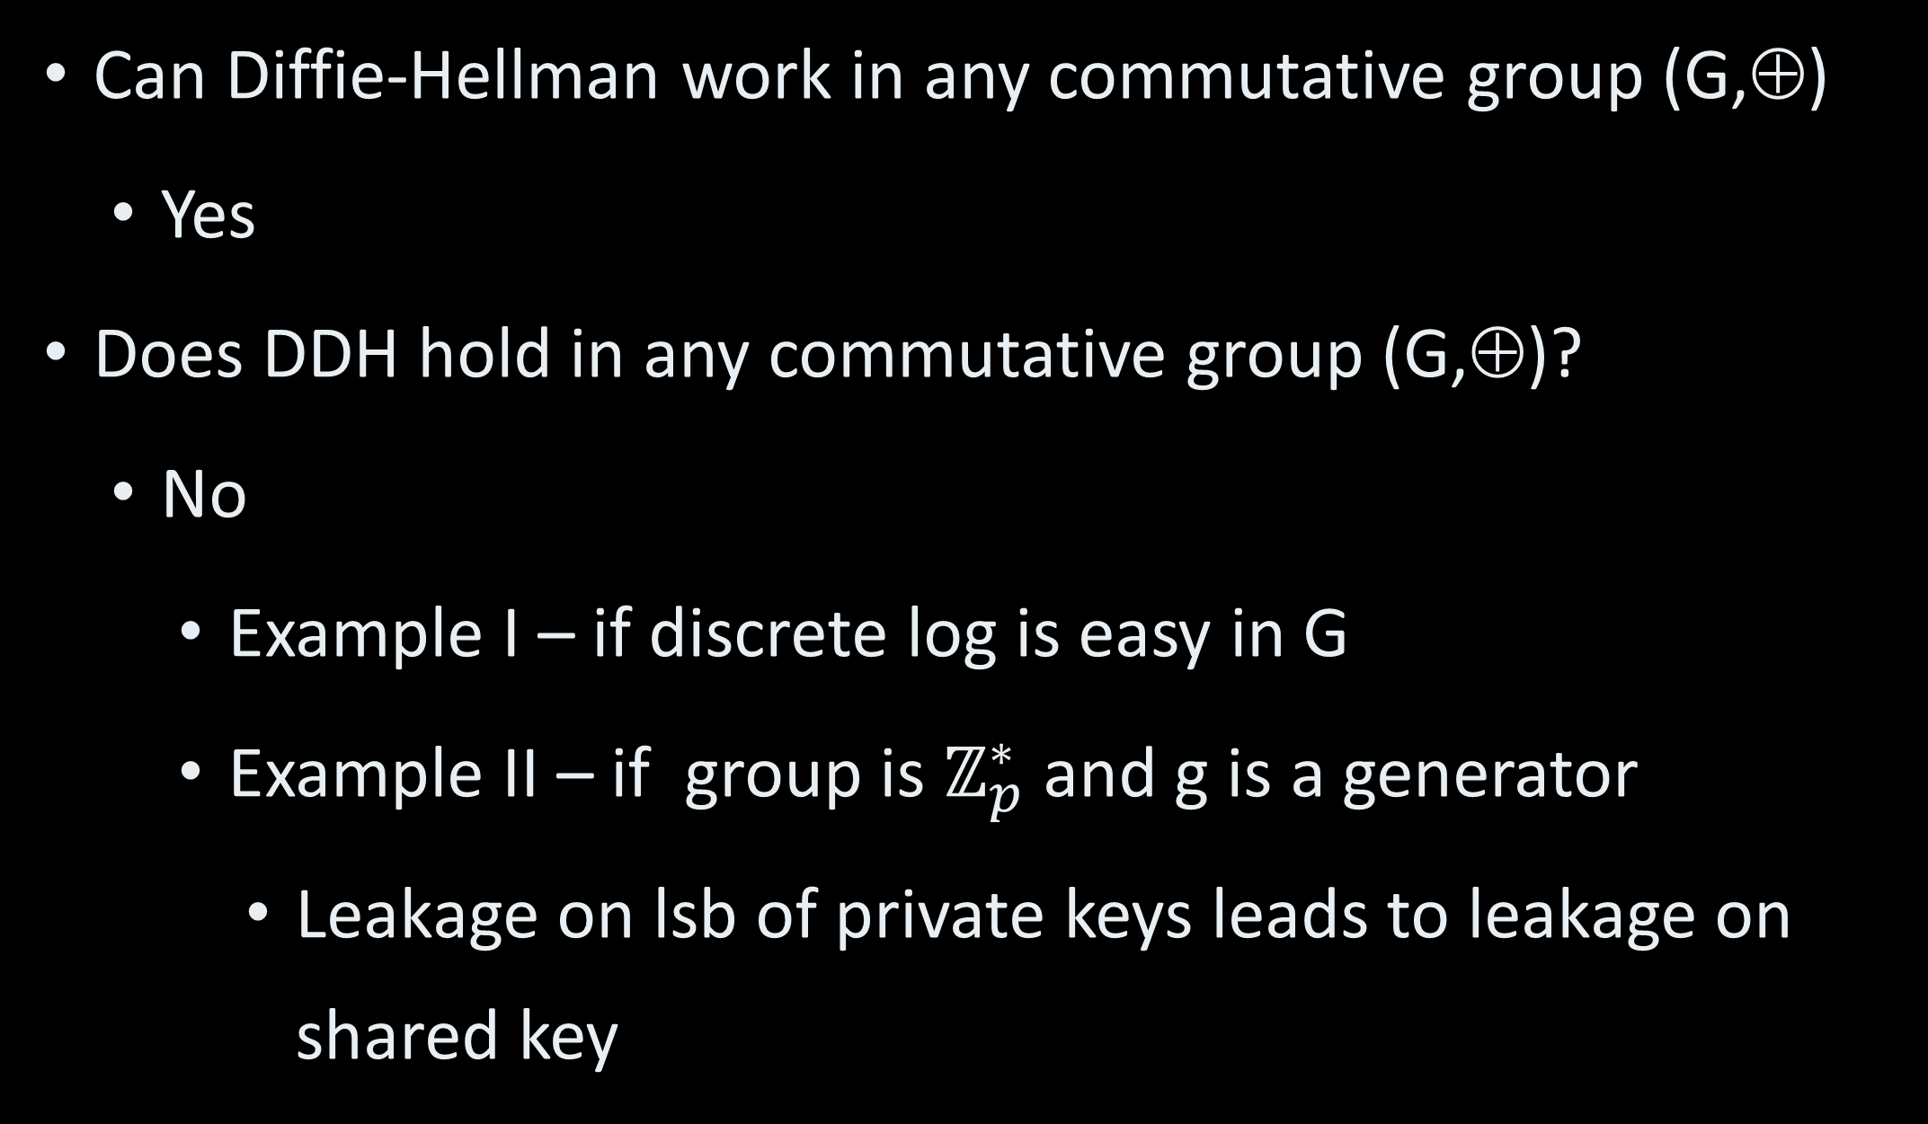
DH Security II
Can Diffie-Hellman work in any commutative group (G,⊕)
Yes
Does DDH hold in any commutative group (G,⊕)?
No
Example I – if discrete log is easy in G
Example II – if group is $ℤ_{p}^{∗}$ and g is a generator
Leakage on lsb of private keys leads to leakage on shared key

Slide 39
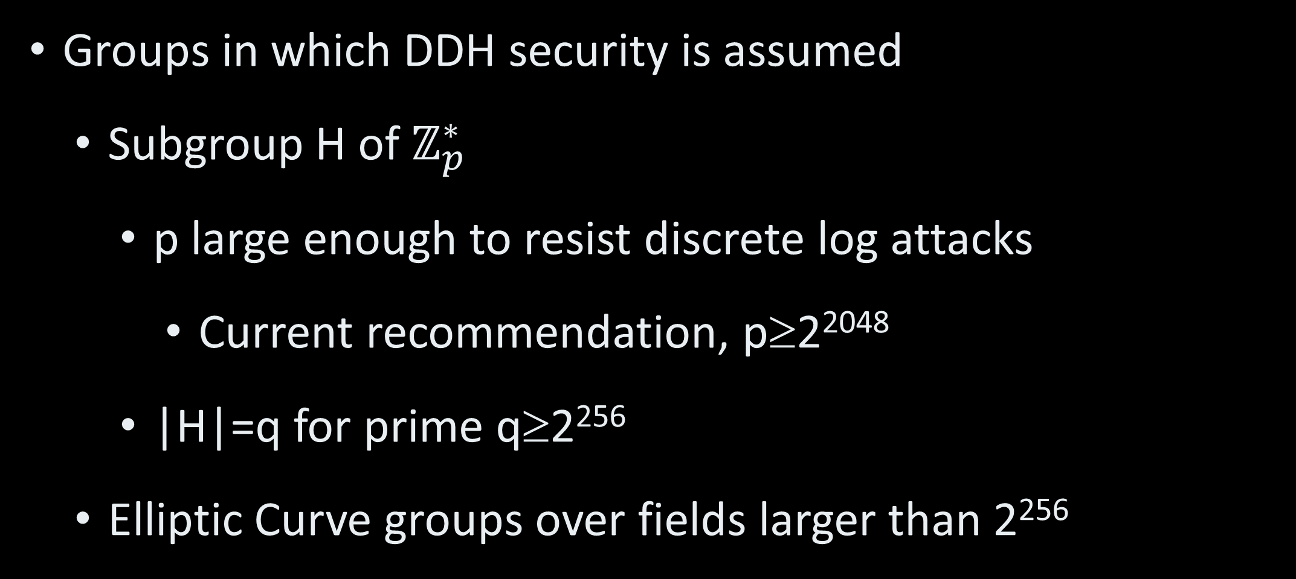
DDH Secure Groups
Groups in which DDH security is assumed
Subgroup H of $ℤ_{p}^{∗}$
p large enough to resist discrete log attacks
Current recommendation, p≥2²⁰⁴⁸
|H|=q for prime q≥2²⁵⁶
Elliptic Curve groups over fields larger than 2²⁵⁶

Slide 40
Virtual Private Network I
VPN usually has two phases
Phase I - Handshake protocol:
Key exchange between parties sets symmetric keys
Shared key g^{xy} → H(g^{xy}) for cryptographic hash function H
Encryption / integrity keys – separate parts of H(g^{xy})

Slide 41
Virtual Private Network II
Phase II - Traffic protocol:
Communication is encrypted and authenticated by symmetric keys
Automatic distribution of keys
Flexibility and scalability
Periodic refreshing of keys
Reduced material for attacks
Recovery from leaks

Slide 42
Man in the Middle I
DH key exchange secure against eavesdropping
Assuming DDH
What about active attack?
Attacker can impersonate legitimate party

Slide 43
Man in the Middle II
Alice
Eve
Bob
p, g
p, g
p, g
Private x
I’m Alice
g^{x} mod p
Private a, b
Private y
I’m Bob
gª mod p
I’m Alice
g^{b} mod p
I’m Bob
g^{y} mod p
Shared key g^{ax} mod p
Shared key g^{by} mod p

Slide 44
Man in the Middle III
Eve has shared keys with Alice and Bob
Eve can
Decrypt any message
Change any message without detection
➔ VPN handshake includes
Key exchange
Party authentication (AKA identification)

